Slide 1
ML project presentation
Stroke prediction model
Jegyeong An, Jarvis Yang

Slide 2


Slide 3
Table of contents
Data load
NAN values
Checking outliers
Univariate Analysis
Multivariate Analysis
gender / age /work type / smoking / hypertension / bmi
Correlation between data attributes

Slide 4
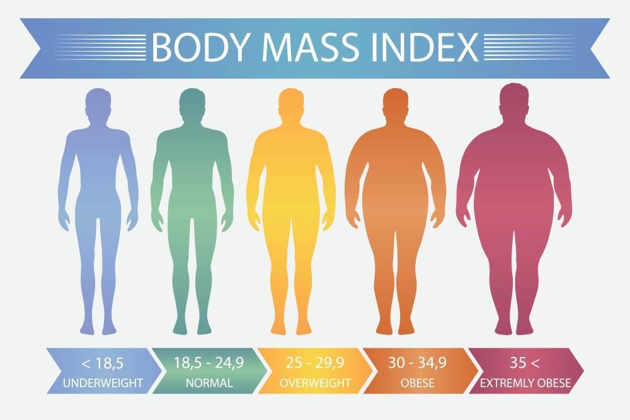
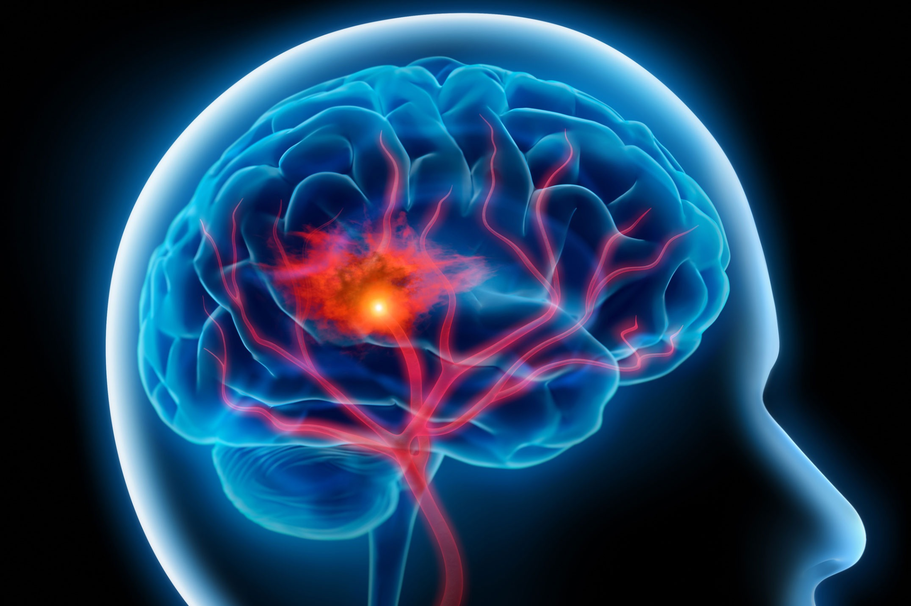


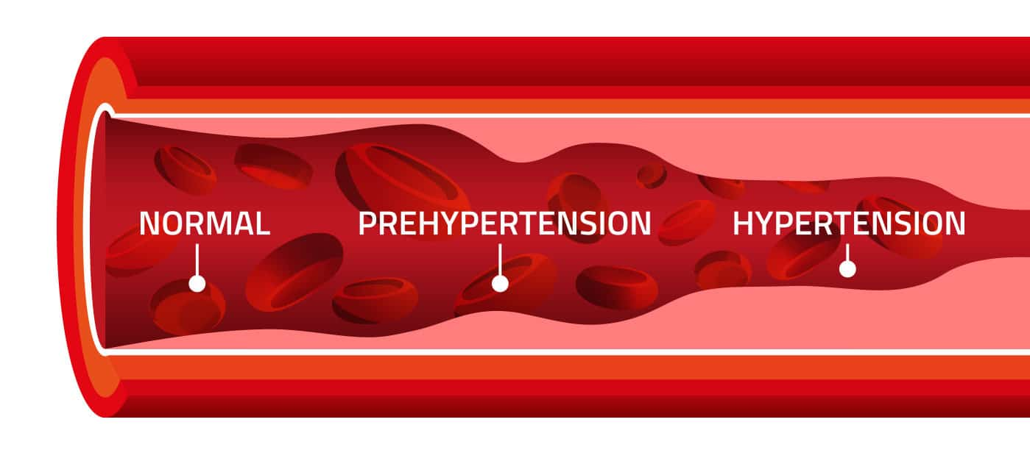
0. Introduction
Stroke prediction is a critical area of research aimed at identifying at-risk individuals using data-driven approaches. This project focuses on building a machine learning model to predict stroke occurrences, leveraging key demographic, health, and lifestyle features to enhance early detection and intervention.

Slide 5
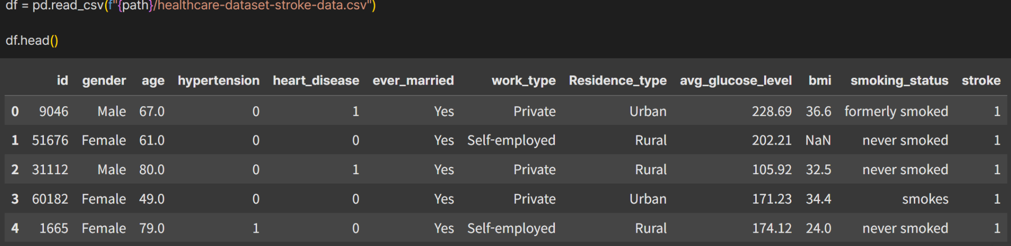
Data Load
There are 10 features in the data frame, and we mainly focused on the below features
gender / age / hypertension / work type / bmi / smoking

Slide 6
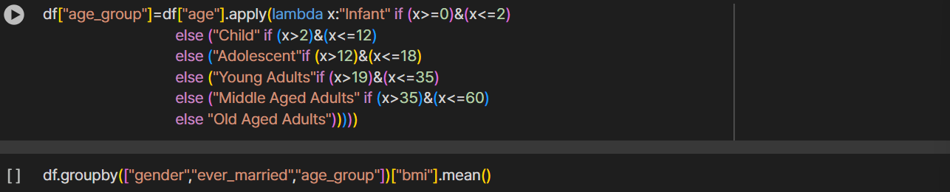
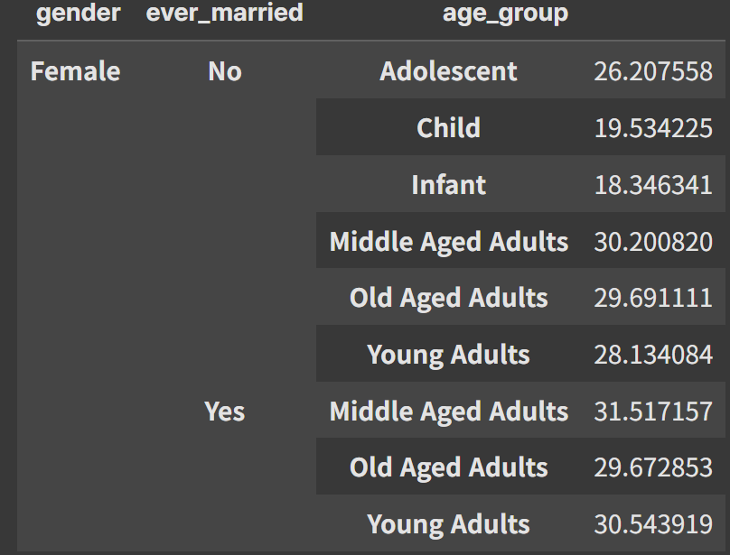
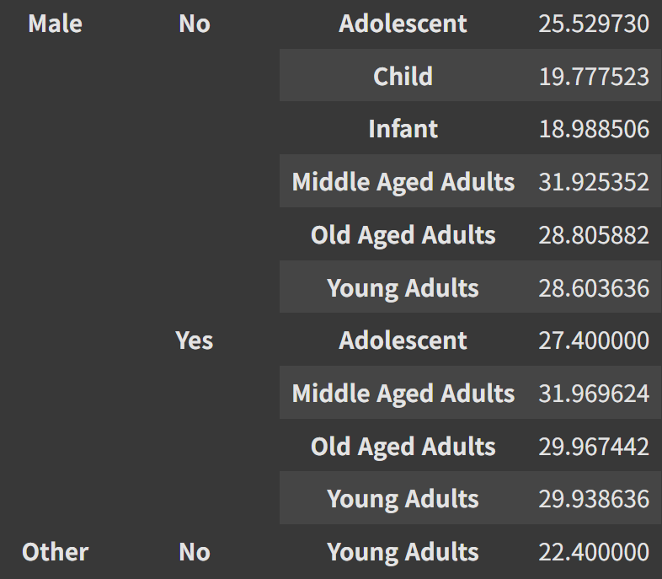
Data Load (categorize)

Slide 7
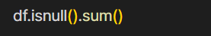
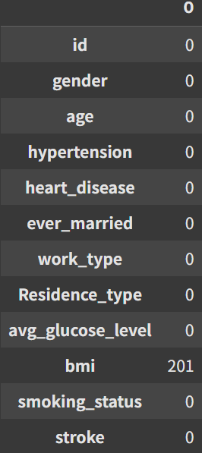
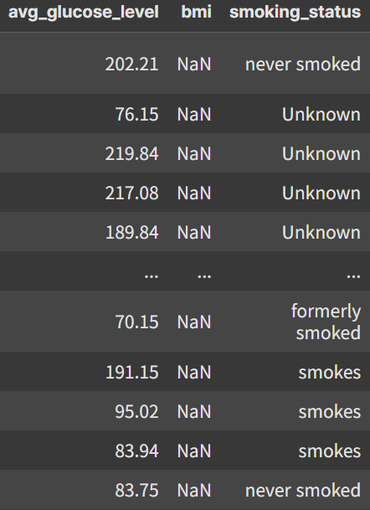
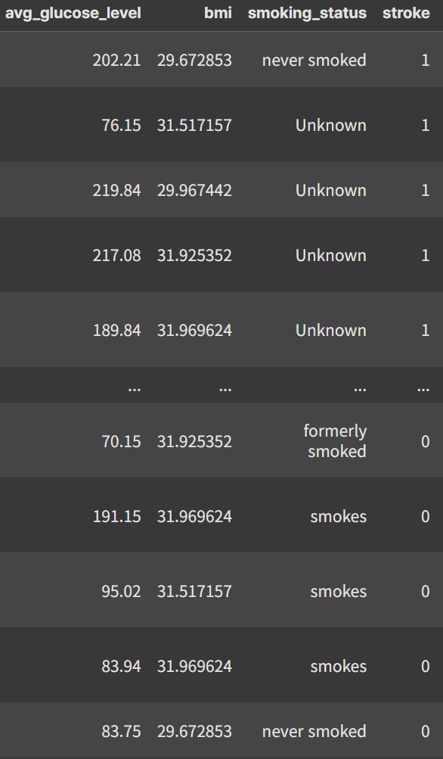
2. NAN values
The missing values were imputed by calculating the average based on gender, marriage status, and age group

Slide 8
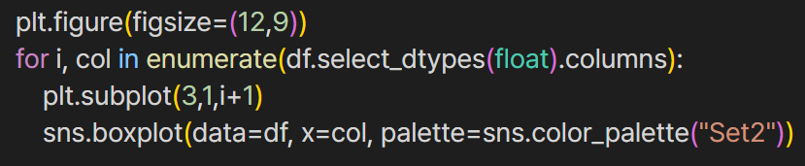
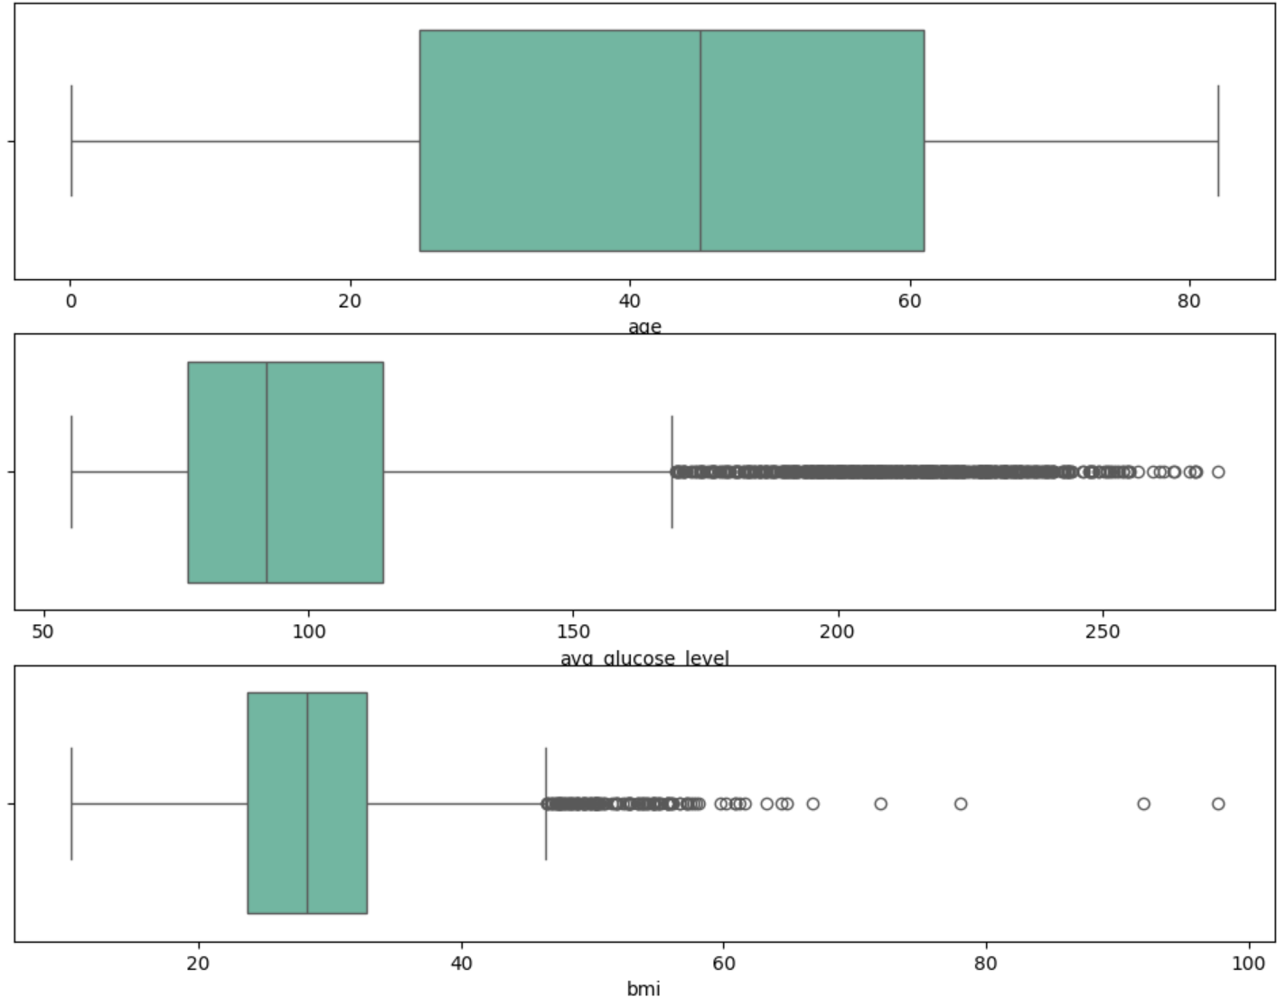
3. Checking outliers
There was a lot of outliers in bmi and avg glucose level, However by searching online most of these values are normal, so we just remove enough to be in the acceptable range

Slide 9
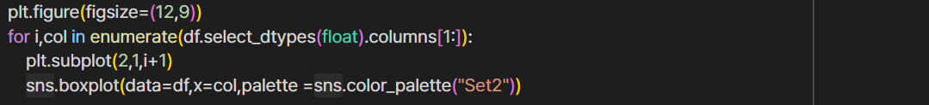
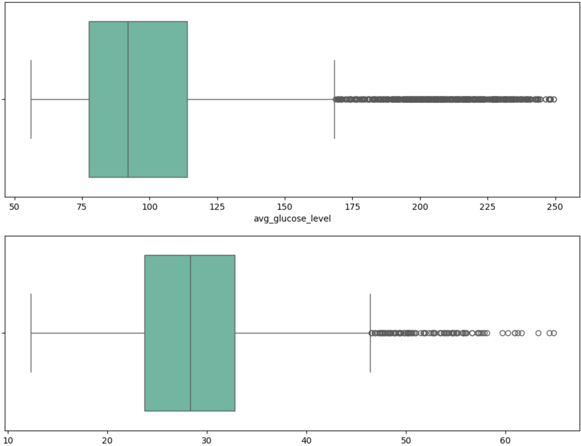
3. Checking outliers
There is still outliers, however removing these will be considered loss of information since these are true outliers

Slide 10
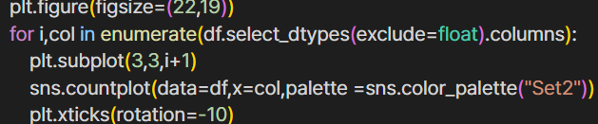
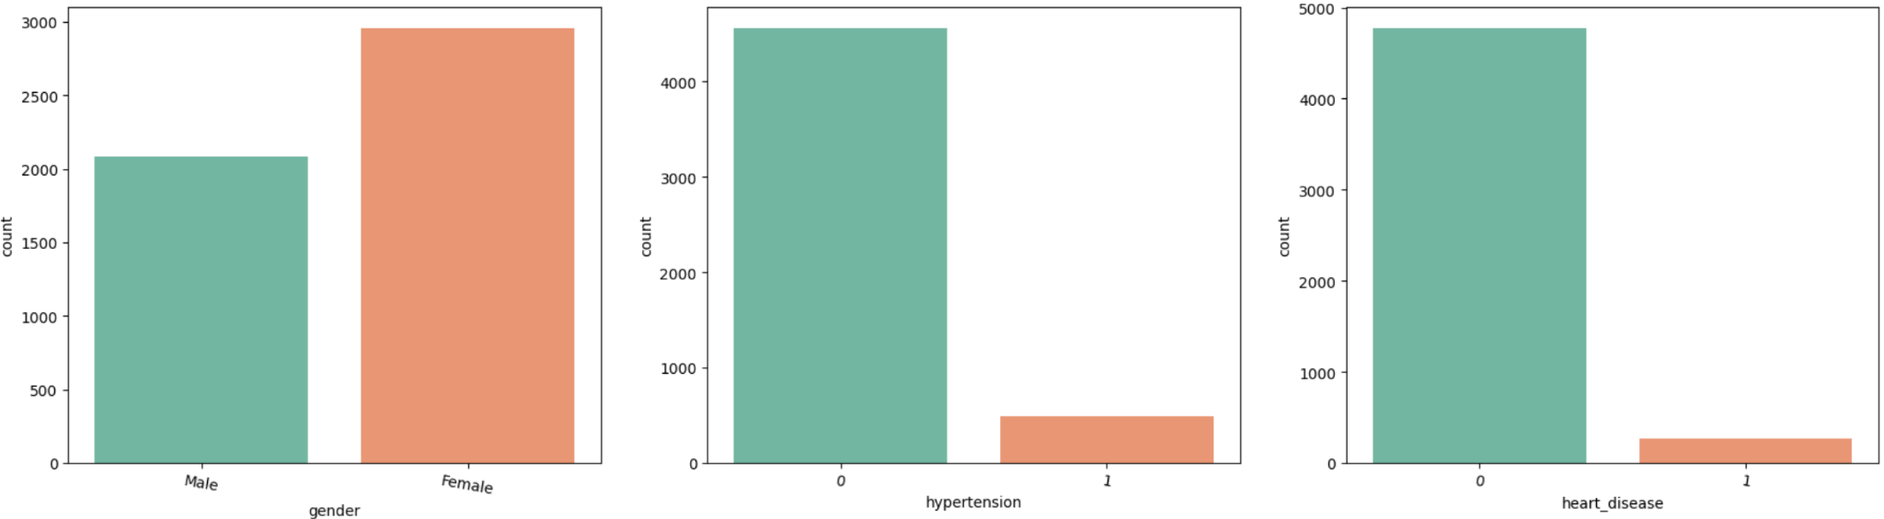
4. Univariate Analysis
The gender distribution shows a higher proportion of females, while hypertension and heart disease are relatively less common

Slide 11
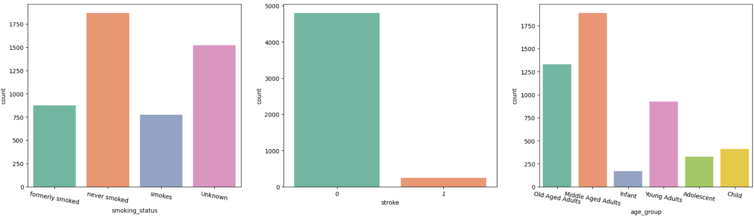
4. Univariate Analysis
In the case of smoking, the status is widely distributed, and the age groups are also well-diversified

Slide 12
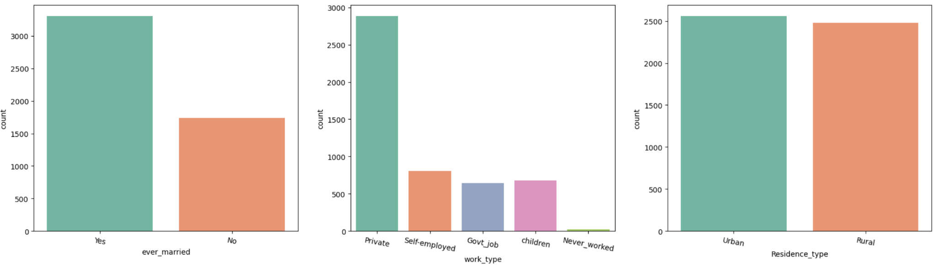
4. Univariate Analysis
Marriage status shows a higher tendency as older individuals make up a larger proportion

Slide 13
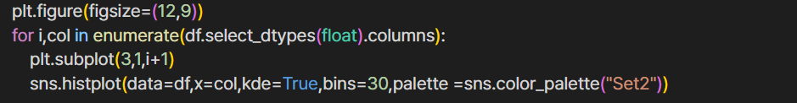
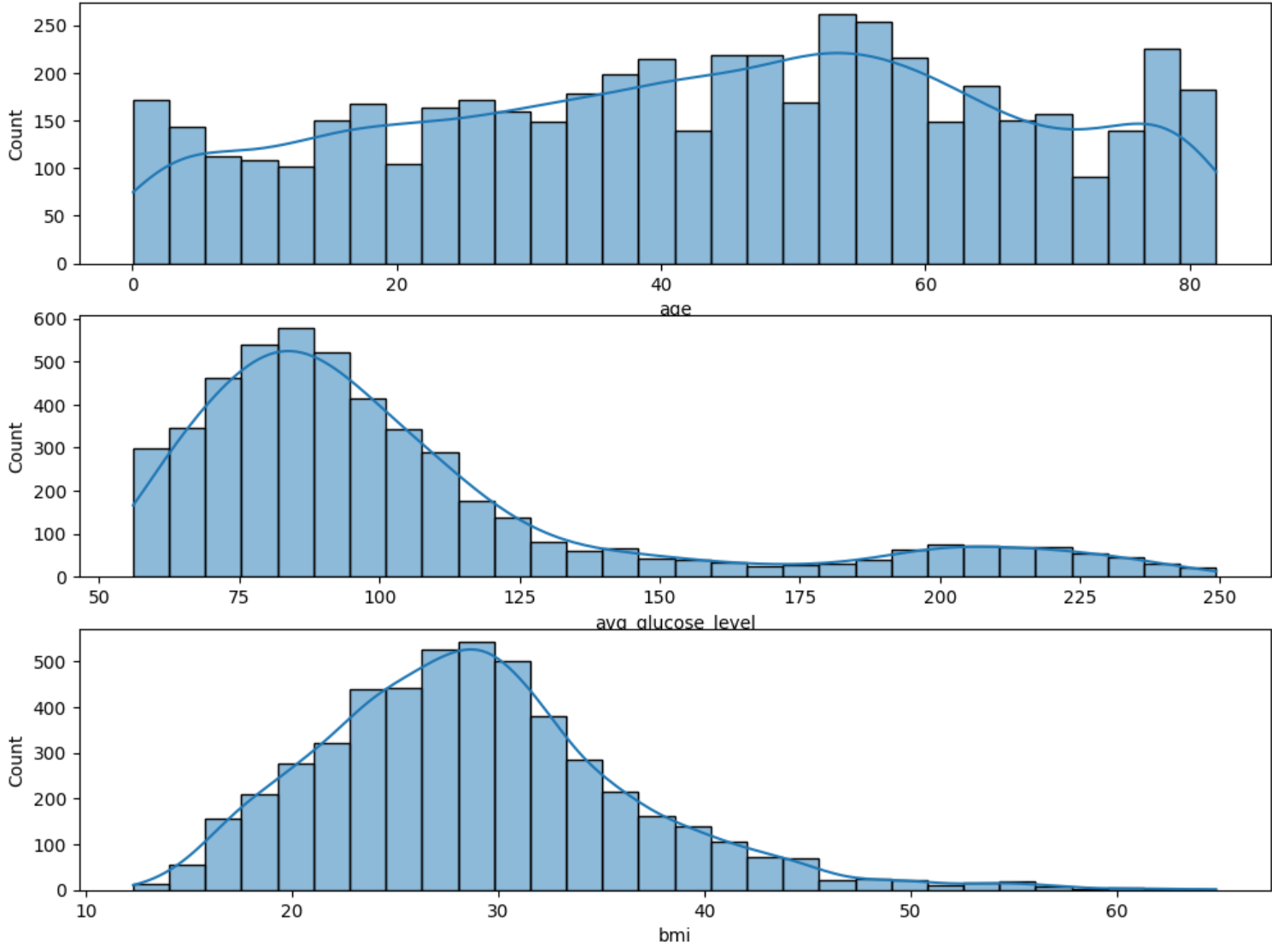
4. Univariate Analysis
when If we represent Quantitative features numerically in a graph, we can observe that it follows a normal distribution

Slide 14
5. Multivariate Analysis (summary)
gender : no relation
age : stroke only happened in older people (mainly old and middle age)
work type : have relation, but not that much, happens more in private work
smoking : smoking have relation with age → due to age(not smoking)
hypertension : have relation, but not that much
bmi : bmi with people who have stroke is 2 points higher than who does not (but It is difficult to say definitively that bmi has a clear impact on stroke)

Slide 15
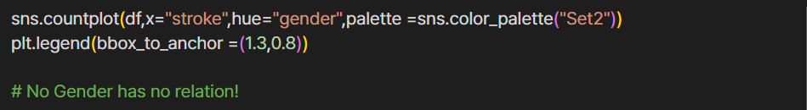
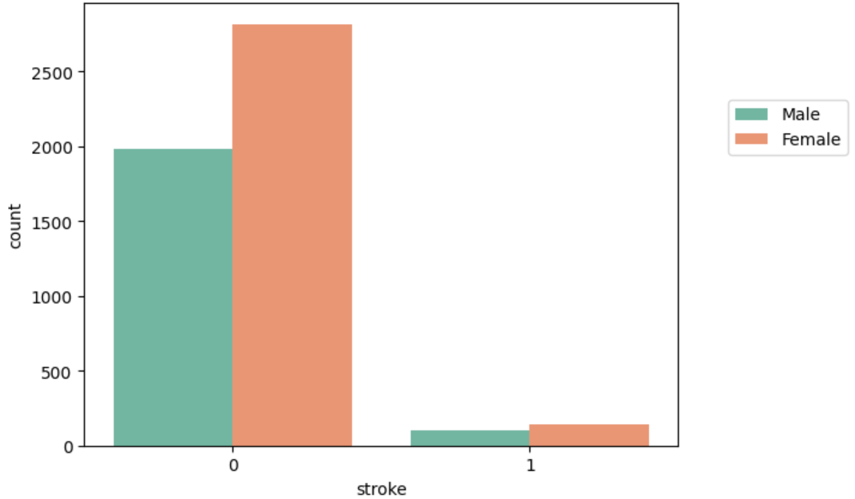
5. Multivariate Analysis - Gender
No Gender has no relation

Slide 16
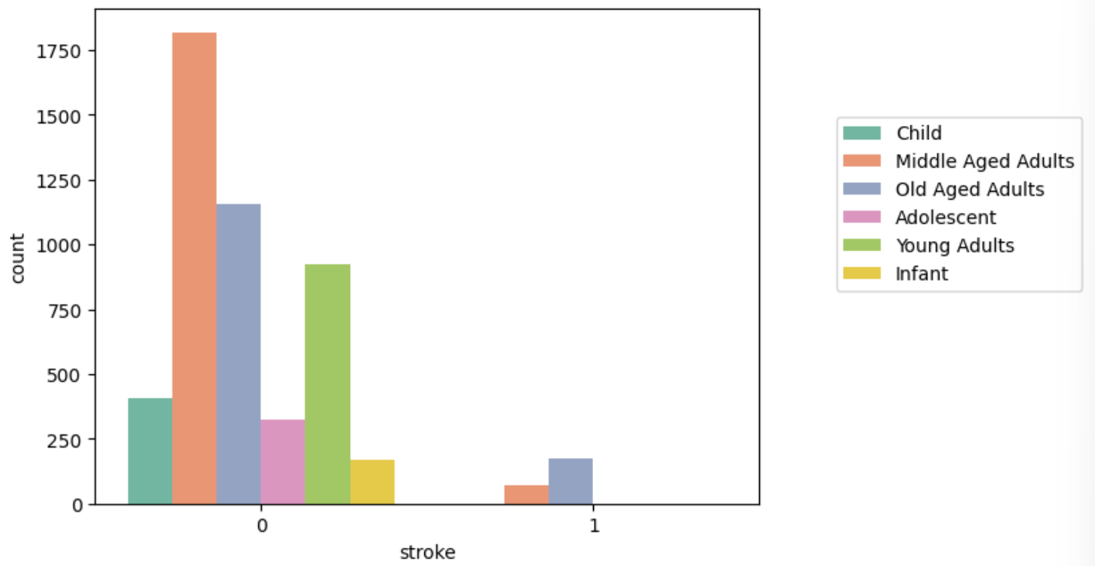
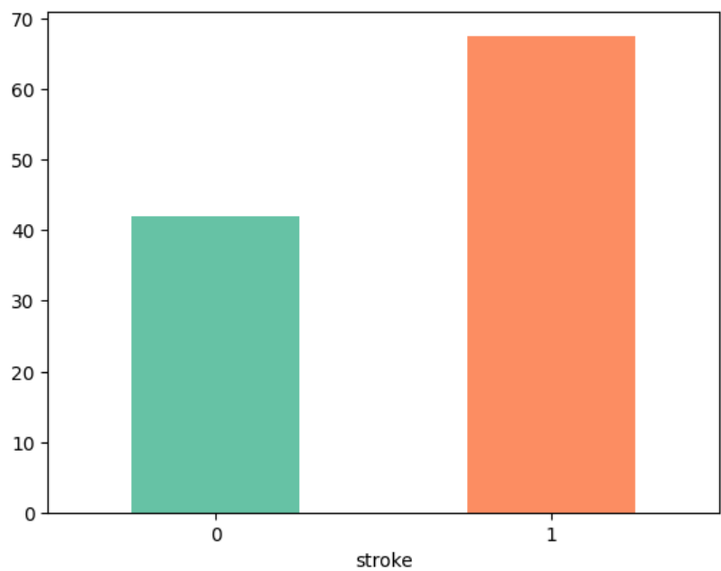
5. Multivariate Analysis - age
Stroke only happened in older people mainly old aged and middle aged adults. In terms of average age, the group with strokes has an average age approximately 25 years higher

Slide 17
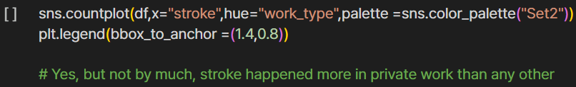
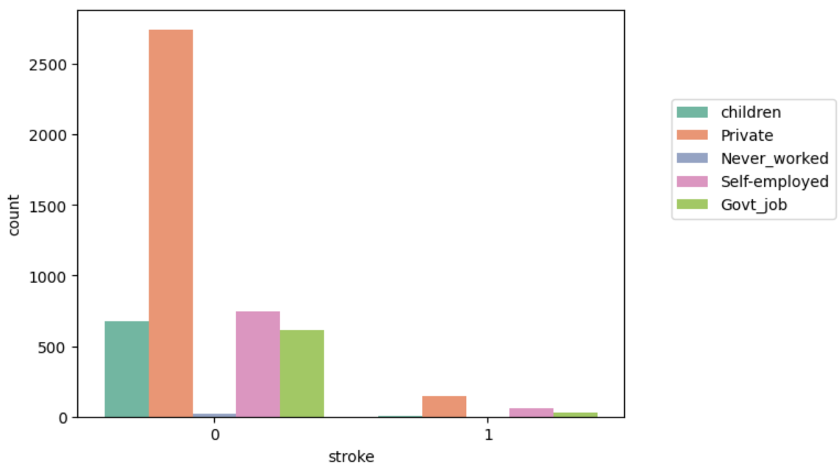
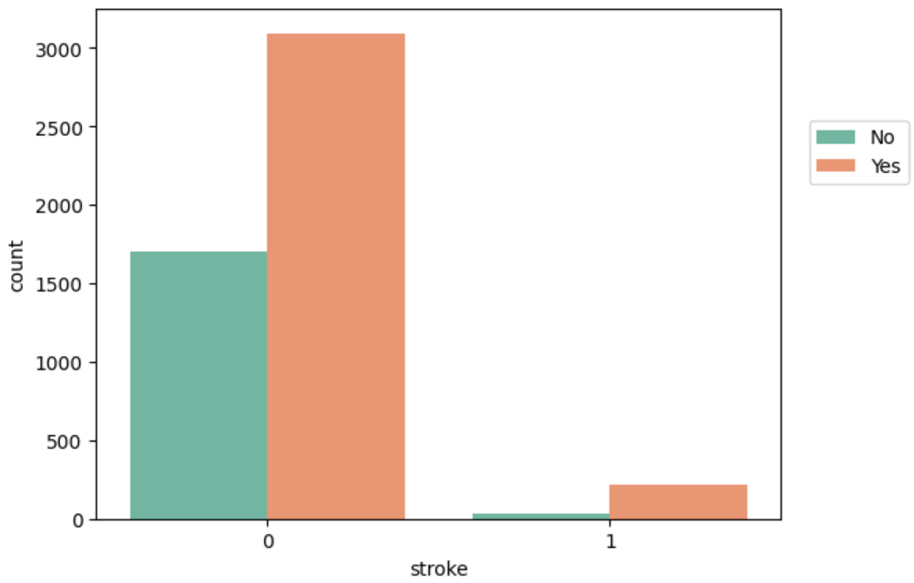
5. Multivariate Analysis - work type
stroke happened more in private work than any other

Slide 18
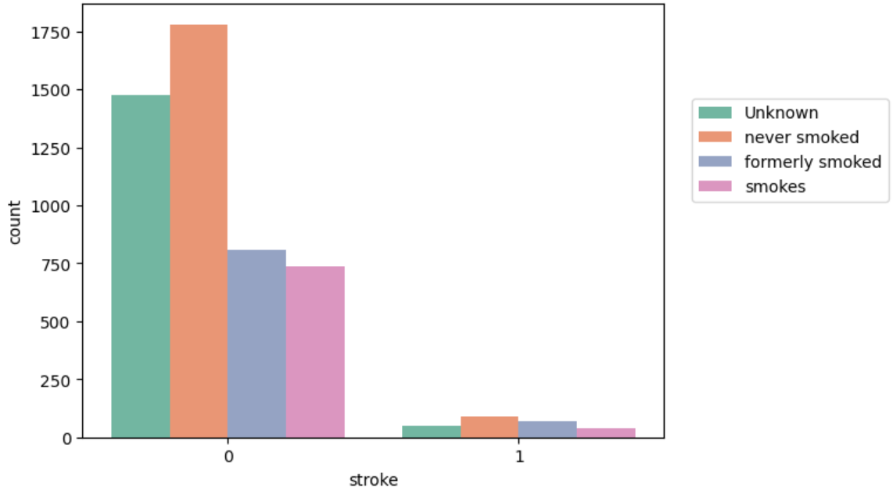
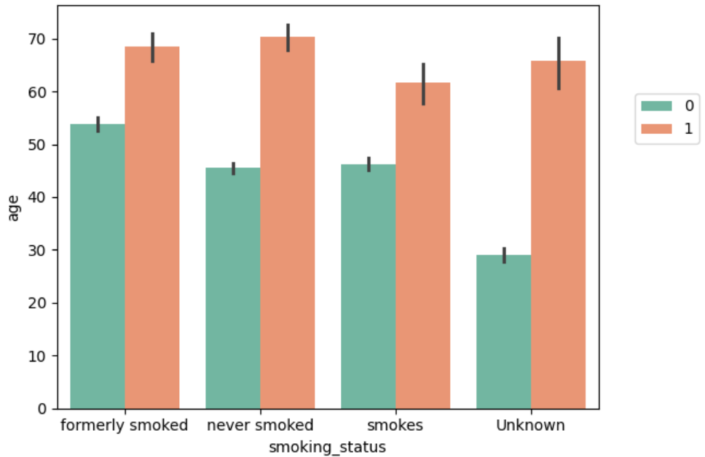
5. Multivariate Analysis - smoking
As seen below , people who never smoked and those who formerly smoked had the most strokes. however when looking at age, the age of these 2 was higher than others so it could be attributed to age rather than smoking status

Slide 19
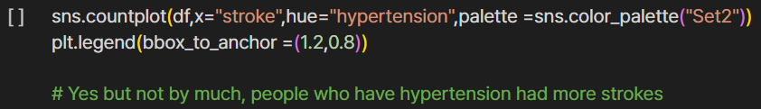
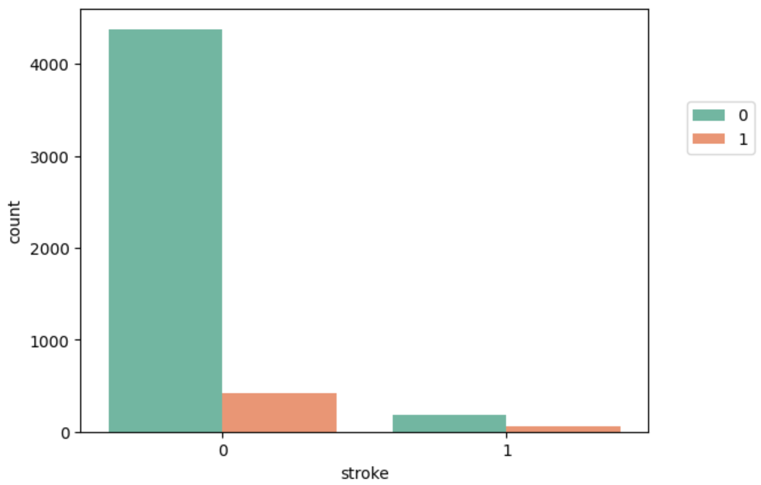
5. Multivariate Analysis - hypertension
We can see that impact on stroke is negligible

Slide 20
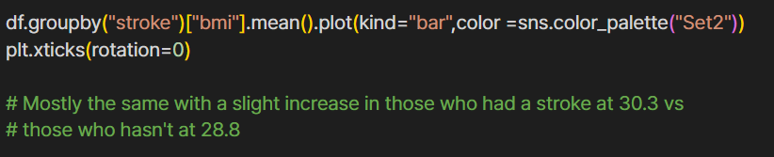
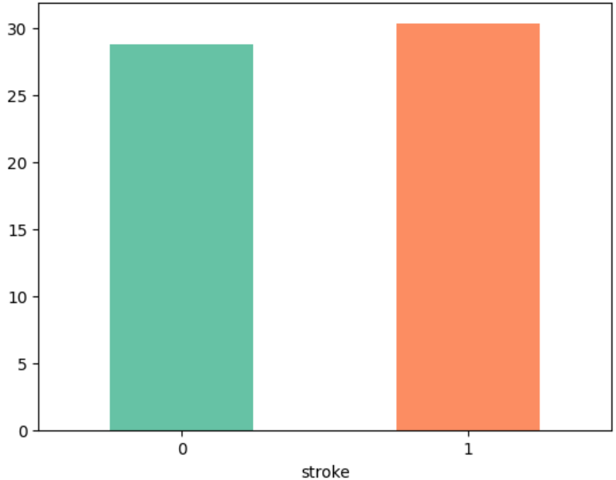
5. Multivariate Analysis - bmi
Average bmi of people who had a stroke vs those who hasn't

Slide 21
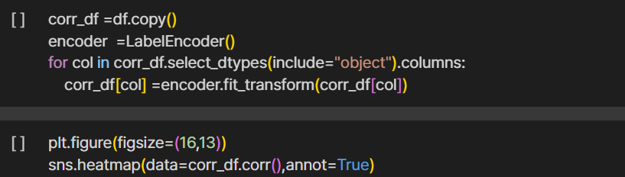
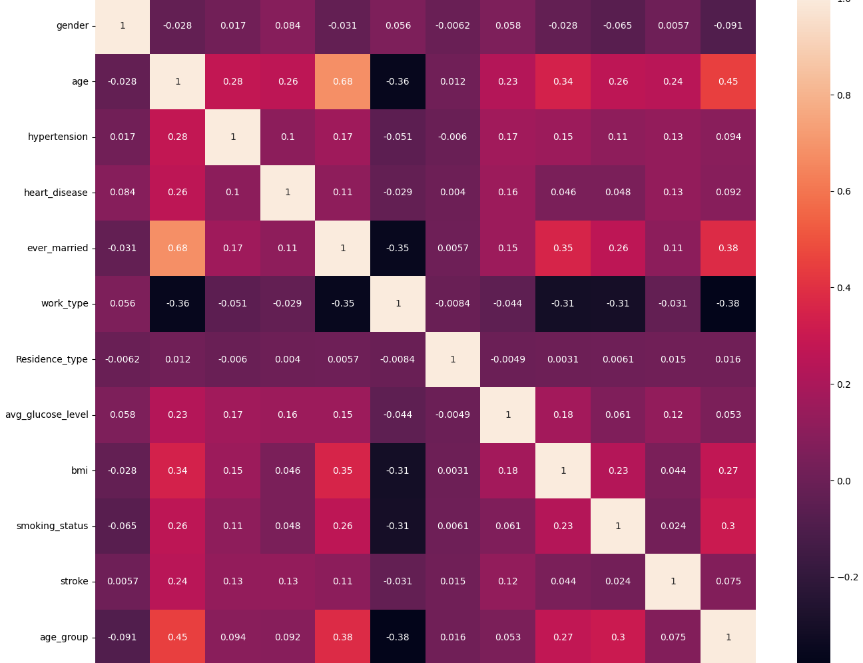
6. Correlation between data attributes

Slide 22
PART 2!!!!

Slide 23
Table of contents
Data Preprocessing
Training Models + Kfold
Evaluating Models
Neural Network Part:
Plans
Model Architecture
Training & Analysis
Adaptive Learning Rate Strategies

Slide 24
Data Preprocessing
Drop ID Column
Fill bmi N/A values with means of samples in similar group
One hot encode categorical data + Label encode ordinal data
Upsample samples with stroke => fix imbalance dataset
Scale all data using MinMax scaler

Slide 25
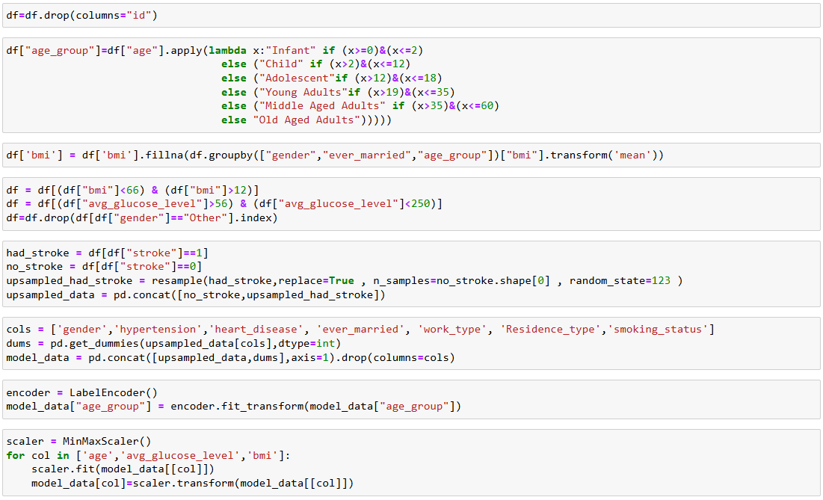
Data Preprocessing

Slide 26
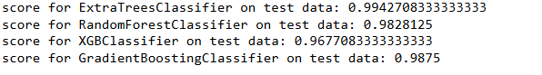
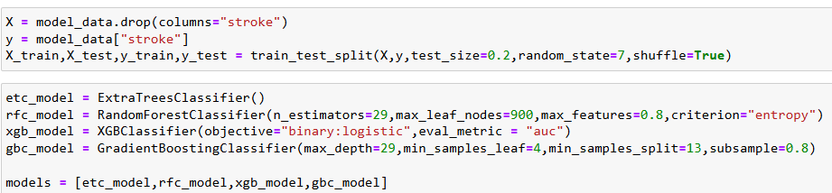
Training Models

Slide 27
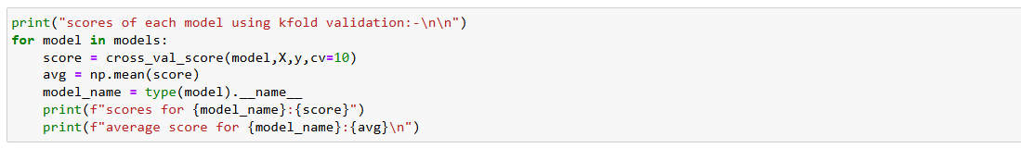
K Fold Cross Validation

Slide 28
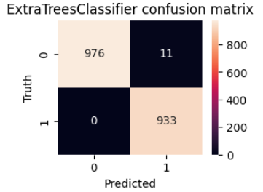
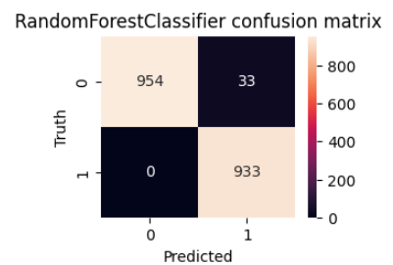
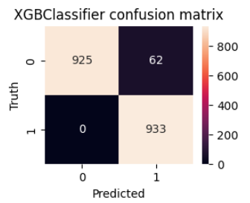
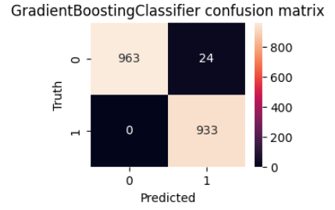
Evaluation
The best model was Extra Trees Classifier followed by Gradient boosting , Random Forest and XGboost
Accuracy for Extra Trees was 99% and average cross validation score of 99%
Accuracy for Random Forest was 98% and average cross validation score of 98%
Accuracy for XGboost was 98% and average cross validation score of 97%
Accuracy for Gradient Boost was 98% and average cross validation score of 98%

Slide 29
Neural Network Part!!!

Slide 30
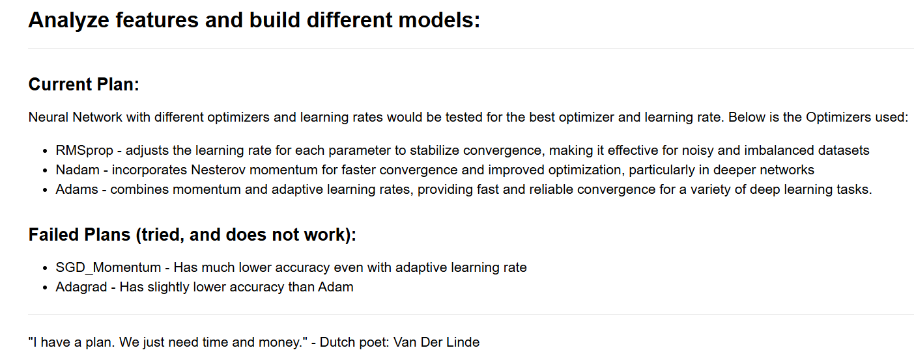

Slide 31
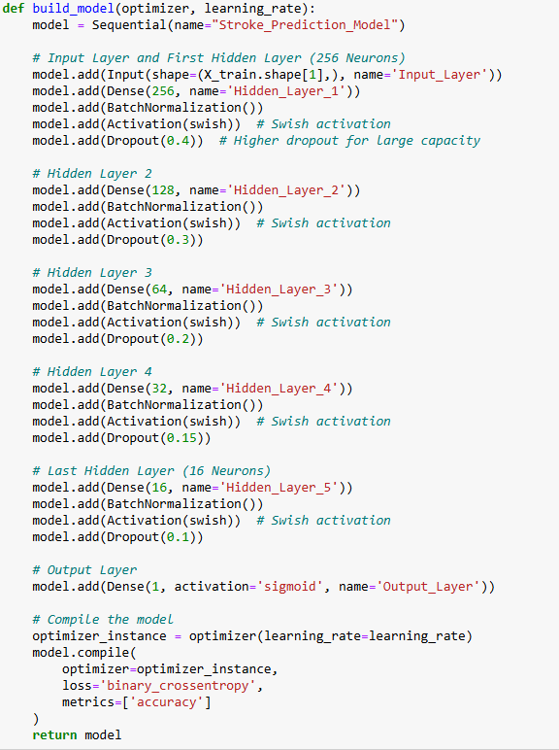
Model Architecture
Activation: Swish(x) = x * sigmoid(x)
Batch Normalization
Dropout Inputs
Designed with overfitting protection in mind

Slide 32
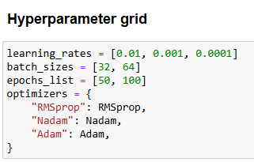
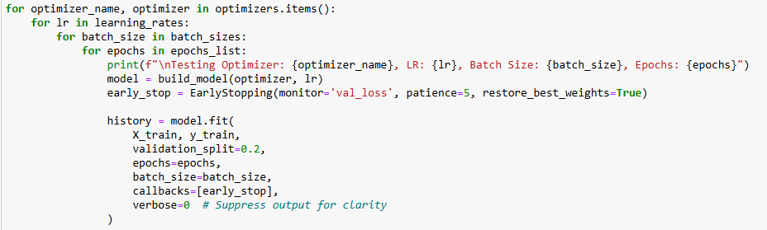
Training Models

Slide 33
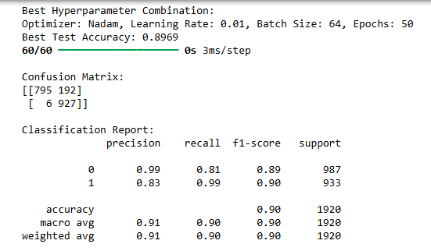
Best Model

Slide 34

Model Summary
Total params: 150,662 (588.53 KB)
Trainable params: 49,889 (194.88 KB)
Non-trainable params: 992 (3.88 KB)
Optimizer params: 99,781 (389.77 KB)

Slide 35

Accuracy Analysis 1

Slide 36

Accuracy Analysis 2

Slide 37
Adaptive Learning Rate
Strategies:
Reduce Learning Rate On Plateau
Cyclical Learning Rate (CLR) + Triangular 2

Slide 38
Adaptive Learning Rate Result
Cannot further improve the performance of the best model
Accuracy of RMSprop got slightly improved with Reduce LR on Plateau
Got worse with CLR with Triangular 2

Slide 39
Q & A

Slide 40
Thank You!!!!
JARVIS843/Stroke_Prediction_ML_Project: Various machine learning models that predict whether people of all age groups are going to have strokes.

